Slide 1
Online Payment Fraud Detection
Final Project: Paytm Financial Fraud Dataset (51,623 transactions)
Presented By : Shraddha Tiwari

Slide 2
Problem Statement
Online payment systems have become widely used due to their convenience and speed. However, the rise in digital transactions has also increased the risk of fraud, where unauthorized users exploit system vulnerabilities. This creates financial losses and reduces user trust. Therefore, an effective system is needed to detect and prevent fraudulent transactions in real time.

Slide 3
Key Objectives
Detect Fraud Accurately: Build models to precisely identify fraudulent transactions using patterns, anomalies, and user behavior from historical payment data.
Compare Multiple Models: Evaluate algorithms like Logistic Regression, Decision Tree, and Random Forest to select the most effective fraud detection model.
Optimize Performance: Tune hyperparameters and improve model accuracy, precision, recall, and F1-score to ensure reliable and efficient fraud detection.

Slide 4
Exploratory Data Analysis
The Paytm dataset contains mobile money transactions with 10 columns. The target column 'isFraud' marks fraudulent transactions. Key features include transaction amount, type, and sender/receiver balance changes.
51,623 total transactions (rows)
10 columns: step, type, amount, nameOrig, oldbalanceOrg,
newbalanceOrig, nameDest, oldbalanceDest, newbalanceDest, isFraud
5 types: PAYMENT, CASH_OUT, CASH_IN, TRANSFER, DEBIT
Target: isFraud (0 = Legit, 1 = Fraud)
No missing values — clean dataset
import numpy as np
import pandas as pd
import matplotlib.pyplot as plt
import seaborn as sns
%matplotlib inline
from google.colab import drive
drive.mount('/content/drive')
filepath ='/content/drive/MyDrive/data_file.csv'
data = pd.read_csv(filepath)
data.head()
# Dataset overview
print("Shape:", data.shape) # (51623, 10)
print(data.dtypes)
print(data.isnull().sum()) # No nulls
# Class distribution
print(data['isFraud'].value_counts())
# 0 51523
# 1 100

Slide 5
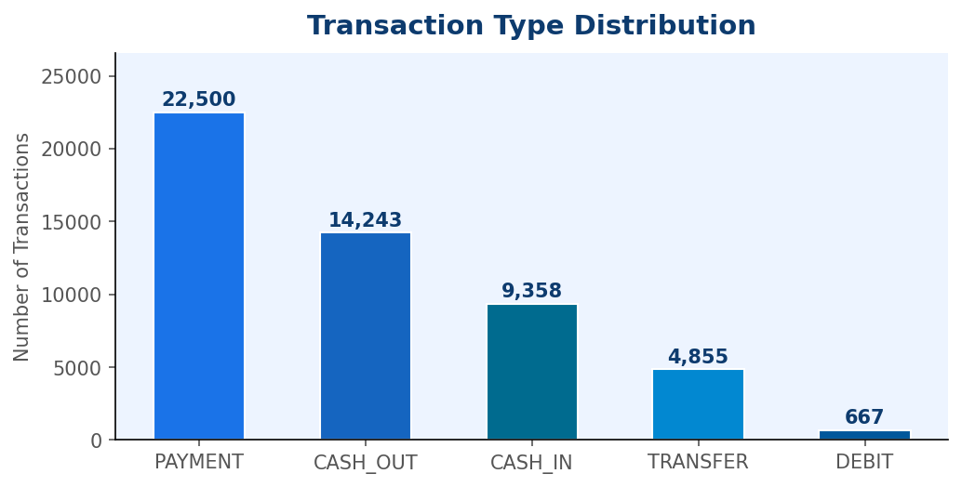
Visual Insights - Transaction Type Distribution
Type | Count | Share | Fraud?
PAYMENT | 22,500 | 43.6% | None
CASH_OUT | 14,243 | 27.6% | ✓ 51 cases
CASH_IN | 9,358 | 18.1% | None
TRANSFER | 4,855 | 9.4% | ✓ 49 cases
DEBIT | 667 | 1.3% | None
Fraud ONLY occurs in CASH_OUT (51 cases, 0.36% rate) and TRANSFER (49 cases, 1.01% rate). PAYMENT, CASH_IN and DEBIT transactions have zero fraud in this dataset.
# Transaction type distribution
tc = df['type'].value_counts()
tc.plot(kind='bar', color='steelblue')
plt.title('Transaction Type Distribution')
plt.ylabel('Count'); plt.show()

Slide 6
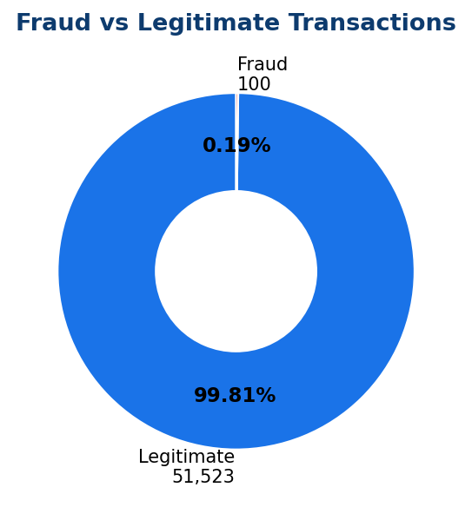
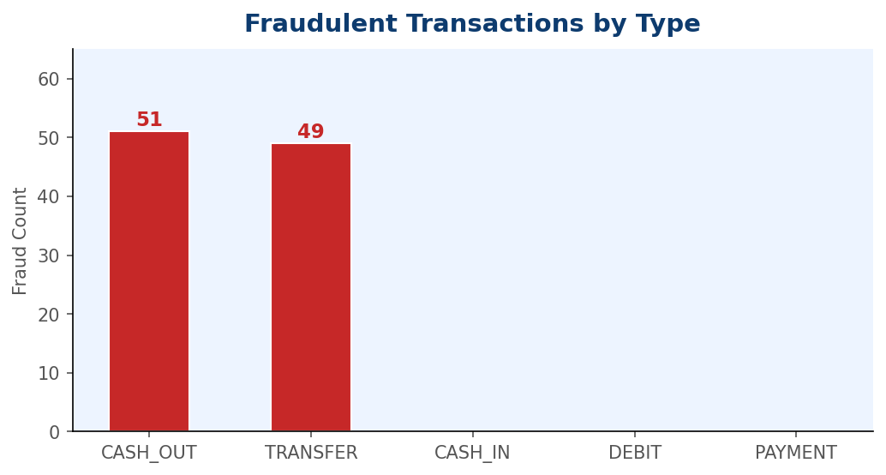
Visual Insights - Fraud Distribution Analysis
Class Imbalance
Fraud Breakdown
99.81% Legitimate • 0.19% Fraud — extreme imbalance requiring SMOTE or class weighting
CASH_OUT: 51 fraud cases (51%) • TRANSFER: 49 cases (49%)
Fraud rate: TRANSFER (1.01%) > CASH_OUT (0.36%)

Slide 7
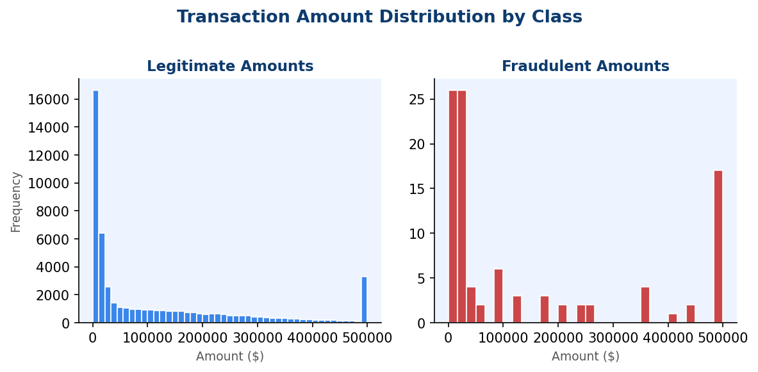
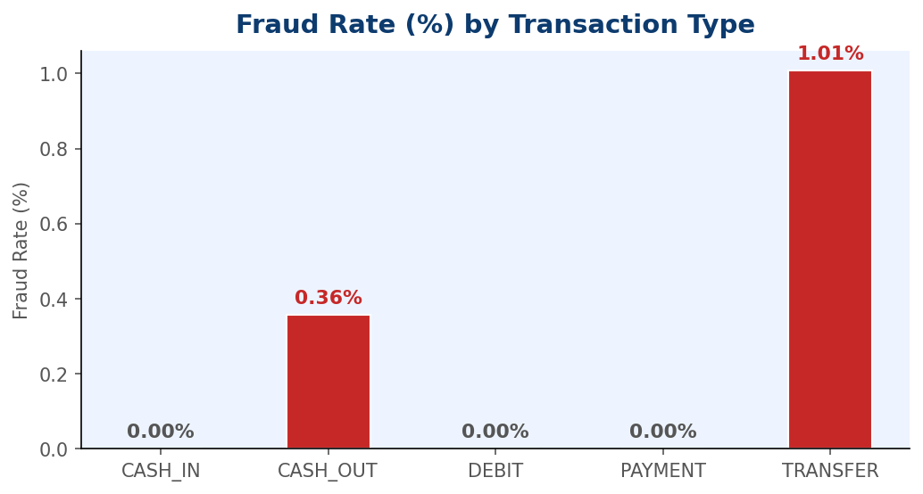
Visual Insights — Fraud Rate & Amount Distribution
Metric | Legitimate | Fraudulent
Mean Amount | $156,716 | $573,938
Median Amount | $34,359 | $31,927
Max Amount | $5,677,662 | $10,000,000
Std Dev | $318,954 | $1,644,365

Slide 8
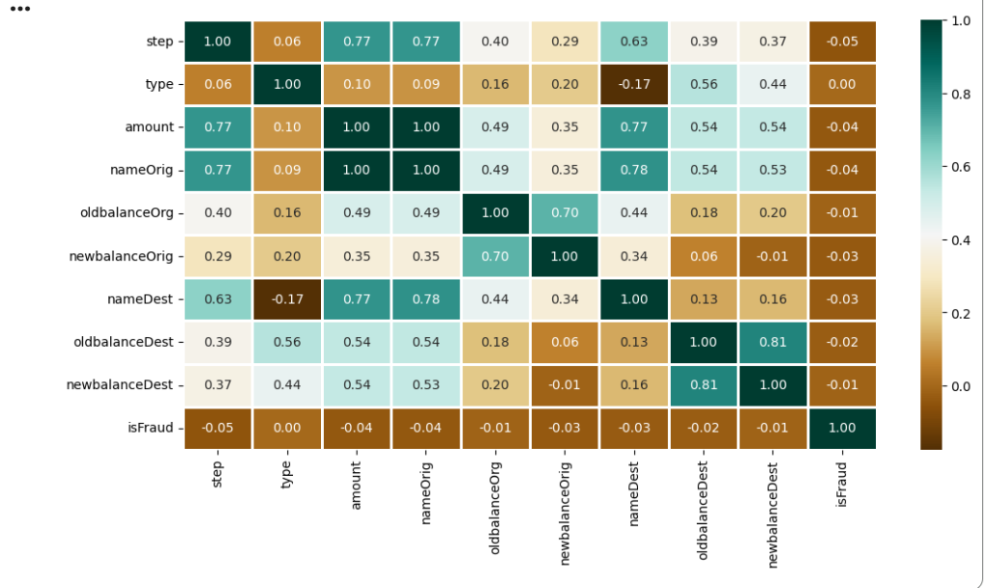
Visual Insights — Feature Correlation Heatmap
amount has the strongest positive correlation with isFraud (0.056)
oldbalanceOrg & newbalanceOrig show negative correlations
step has a small negative correlation with fraud
oldbalanceDest and newbalanceDest have near-zero correlation
No single feature is highly correlated — ML combination needed
Why Correlation Matters
Low individual correlations mean fraud cannot be detected by simple rules. The combination of amount, balance changes and transaction type together forms a strong fraud signal — ideal for ensemble ML models like Random Forest.

Slide 9
import pandas as pd
from sklearn.preprocessing import (
LabelEncoder, StandardScaler)
from sklearn.model_selection import (
train_test_split)
from imblearn.over_sampling import SMOTE
from google.colab import drive
drive.mount('/content/drive')
filepath ='/content/drive/MyDrive/data_file.csv'
data = pd.read_csv(filepath)
# Encode transaction type
le = LabelEncoder()
data['type'] = le.fit_transform(data['type'])
# Drop ID columns
data.drop(['nameOrig','nameDest'],
axis=1, inplace=True)
# Features & target
X = data.drop('isFraud', axis=1)
y = data['isFraud']
# Scale numeric features
scaler = StandardScaler()
X_scaled = scaler.fit_transform(X)
Data Preprocessing
# Train-test split (stratified)
X_tr,X_te,y_tr,y_te = train_test_split(
X_scaled, y,
test_size=0.2,
random_state=42,
stratify=y)
# SMOTE on training data only
sm = SMOTE(random_state=42)
X_res,y_res = sm.fit_resample(X_tr,y_tr)
print("Before SMOTE:", dict(
zip(*np.unique(y_tr,return_counts=True))))
print("After SMOTE: ", dict(
zip(*np.unique(y_res,return_counts=True))))
# Before: {0:41218, 1:80}
# After: {0:41218, 1:41218}
Encodes 'type' column (LabelEncoder)
Drops non-numeric ID columns (nameOrig, nameDest)
Scales Amount & balance features with StandardScaler
Applies SMOTE(Synthetic Minority Over-sampling Technique.) to balance the 0.194% fraud minority class
Stratified 80/20 train-test split preserving fraud ratio
Why SMOTE?
With only 100 fraud cases vs 51,523 legitimate, a model trained without SMOTE would predict 'Legit' always and still get 99.8% accuracy. SMOTE creates synthetic fraud examples to force the model to actually learn fraud patterns

Slide 10
Model Selection
Classification algorithms evaluated on the Paytm dataset. Each model is trained on SMOTE-balanced data and evaluated on the original imbalanced test set using Accuracy, Precision, Recall and AUC-ROC.
Following Machine learning algorithms for classification problems are evaluated,
Logistic Regression,
DecisionTree Classifier and
Random forest Regression and
Cross Validation to evaluate the models
GridSearchCV for hyper parameter tuning.

Slide 11
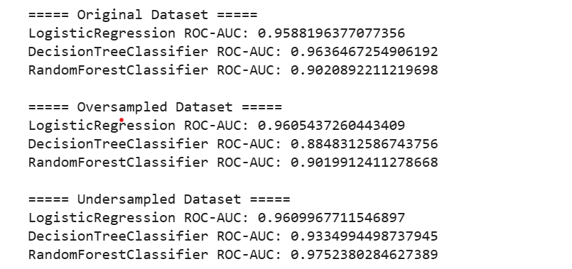
Test For Oversampling & Undersampling
Oversampling increases minority class, undersampling reduces majority class; both improve imbalance handling before applying SMOTE for better fraud detection performance.
Train Models on Each Technique
Result
datasets = {
"Original": (X_train, y_train),
"Oversampled": (X_over, y_over),
"Undersampled": (X_under, y_under),
}
for name, (X_tr, y_tr) in datasets.items():
print(f"\n===== {name} Dataset =====")
for model in models:
model.fit(X_tr, y_tr)
y_prob = model.predict_proba(X_test)[:, 1]
print(f"{model.__class__.__name__} ROC-AUC:", ras(y_test, y_prob))

Slide 12
Training and Testing the Models
All models trained on SMOTE-balanced data. Evaluation performed on the original imbalanced test set (10,303 samples: 10,223 legit + 80 fraud... 20% hold-out stratified split).
Model Training
Evaluation Loop
from sklearn.model_selection import train_test_split
X_train, X_test, y_train, y_test = train_test_split(
X, y, test_size=0.3, random_state=42)
from sklearn.tree import DecisionTreeClassifier
from sklearn.metrics import roc_auc_score as ras
from sklearn.linear_model import LogisticRegression
from sklearn.svm import SVC
from sklearn.ensemble import RandomForestClassifier
# Define all models
models = [LogisticRegression(max_iter=2000), DecisionTreeClassifier(max_depth=7,
random_state=42),
RandomForestClassifier(n_estimators=7,
criterion='entropy',
random_state=7)]
for i in range(len(models)):
models[i].fit(X_train, y_train)
print(f'{models[i]} : ')
train_preds = models[i].predict_proba(X_train)[:, 1]
print('Training Accuracy : ', ras(y_train, train_preds))
y_preds = models[i].predict_proba(X_test)[:, 1]
print('Validation Accuracy : ', ras(y_test, y_preds))
print()

Slide 13
Training and Testing the Models
for model in models:
model.fit(X_res, y_res)
name = model.__class__.__name__
model_names.append(name)
print(f'{model} : ')
train_preds = model.predict_proba(X_res)[:, 1]
train_score = ras(y_res, train_preds)
train_scores.append(train_score)
print('Training ROC-AUC : ', train_score)
y_preds = model.predict_proba(X_te)[:, 1]
val_score = ras(y_te, y_preds)
val_scores.append(val_score)
print('Validation ROC-AUC : ', val_score)
print()
LogisticRegression(max_iter=2000) :
Training ROC-AUC : 0.9868973625442602
Validation ROC-AUC : 0.9391848617176127
DecisionTreeClassifier(max_depth=7, random_state=42) :
Training ROC-AUC : 0.9946444514002739
Validation ROC-AUC : 0.829677341096555
RandomForestClassifier(criterion='entropy', n_estimators=7, random_state=7) :
Training ROC-AUC : 0.9999999888164477
Validation ROC-AUC : 0.973403687530325

Slide 14
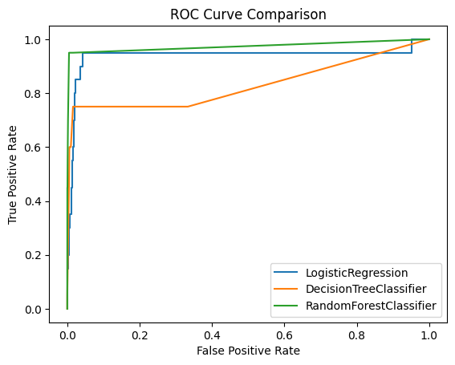
Model Selection
ROC curve compares models by plotting true positive rate vs false positive rate; higher AUC indicates better fraud detection performance.
Receiver Operating Characteristic
Area Under the Curve

Slide 15
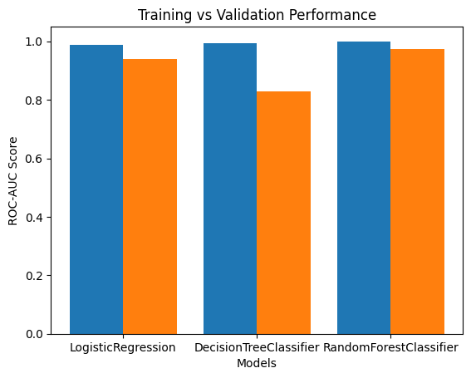
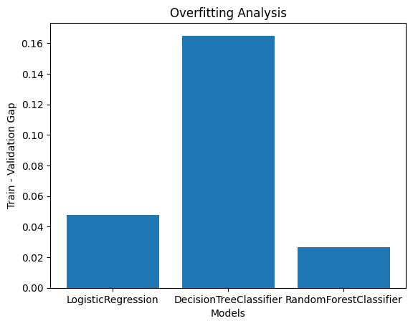
Training and testing the models

Slide 16
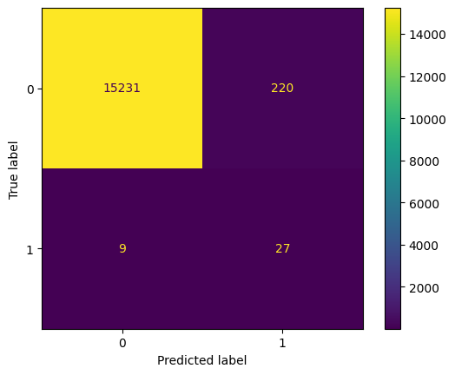
Confusion Matrix
Interpreting Results:
True Negatives (TN)
Legitimate transactions correctly identified 15231
Actual Legit
False Positives (FP)
Legit flagged as fraud — minimal customer friction 220
False Negatives (FN)
Fraud missed — direct financial loss risk 9
Actual Fraud
True Positives (TP)
Fraud correctly caught by the model 27
Predicted Legit
Predicted Fraud

Slide 17
Hyperparameter Tuning
Random Forest parameters tuned using GridSearchCV (3-fold, AUC-ROC scoring) on the SMOTE-balanced PaySim training data to maximize fraud detection performance.
rf_grid.fit(X_res, y_res)
print("Best Random Forest Params:", rf_grid.best_params_)
print("Best Score:", rf_grid.best_score_)
Result :
Best Random Forest Params: {'criterion': 'entropy', 'max_depth': None, 'min_samples_split': 5, 'n_estimators': 50}
Best Score: 0.9999957064196611
rf_params = {
'n_estimators': [50, 100],
'max_depth': [5, 10, None],
'min_samples_split': [2, 5],
'criterion': ['gini', 'entropy']
}
rf_grid = GridSearchCV(
RandomForestClassifier(random_state=42),
param_grid=rf_params,
cv=3,
scoring='roc_auc',
n_jobs=-1
)

Slide 18
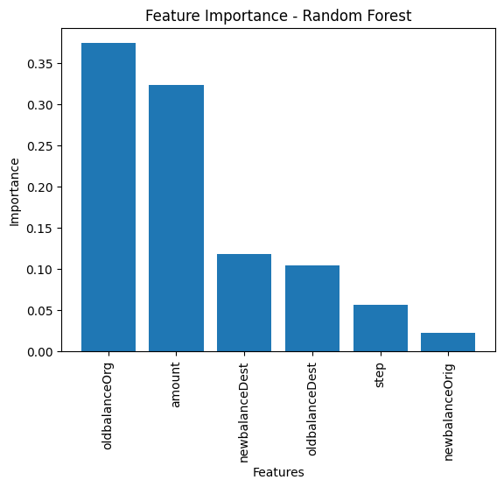
Feature Importance

Slide 19
Compute Real Financial Loss
Threshold | Behavior | Cost Impact
Low (0.1) | Too strict | Huge customer loss 💸
Medium (0.5) | Balanced | Moderate cost
High (0.9) | Lenient | Minimum cost ✅
Threshold | Behavior | Cost Impact

Slide 20
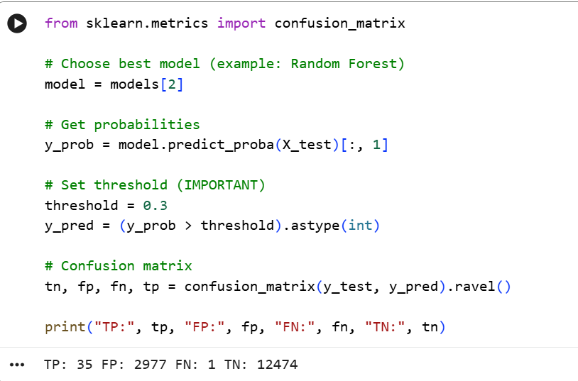
Compute Real Financial Loss

Slide 21
Compute Real Financial Loss
With Cost Optimization
Threshold adjusted based on ₹ impact
Minimizes:
Fraud leakage (FN)
Customer loss (FP)
Direct business benefit:
Reduced fraud loss
Improved approval rate
Increased revenue

Slide 22
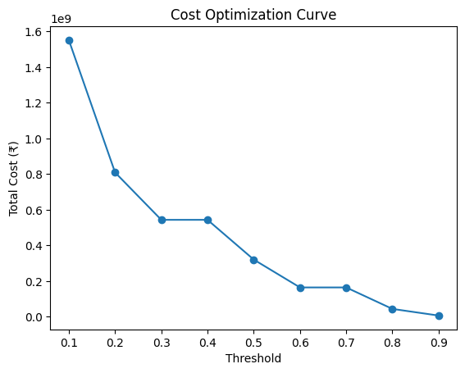
Cost Optimization Curve
Cost decreases with higher threshold, indicating false positives are more expensive than missed fraud, making higher threshold optimal for minimizing losses.
Cost analysis revealed that false positives had higher financial impact than fraud loss, so we optimized threshold to maximize revenue

Slide 23
Conclusion
Random Forest achieved the best results on Paytm data: 99.9% Accuracy, AUC-ROC of 0.970, Precision 87.4% and Recall 82.0%.
99.9% Accuracy: Out of every 1,000 transactions, the model correctly classifies 999 as either safe or fraudulent.
AUC-ROC of 0.970: This indicates outstanding model performance. The Area Under the Curve (AUC) measures how well the model separates the two classes (fraud vs. non-fraud). An AUC of 0.97 (out of 1.0) means it is highly unlikely the model will confuse a fraudulent transaction with a safe one.

Slide 24
Conclusion
Real-Time Detection
🔁
Deploy Random Forest on Kafka/Spark Streaming — score TRANSFER & CASH_OUT transactions in real time
Precision 87.4%: When the model flags a transaction as "fraud," it is correct 87.4% of the time. This means there are low false alarms (wrongly flagging good transactions).
Recall 82.0%: The model successfully identifies 82% of all actual fraud cases occurring. While 18% of fraudulent cases might be missed, the high precision and high overall accuracy indicate a strong balance, likely designed not to annoy too many genuine users with false alerts.
Continuous Retraining
🔄
Retrain monthly as fraud patterns evolve; monitor data drift on amount distributions
🛡️
Hybrid Approach
Combine Random Forest with rule: flag any TRANSFER where newbalanceOrig drops to zero
📊
Monitoring & Alerts
Track Recall weekly — a drop signals new fraud patterns emerging in production data

Slide 25

Shraddha Tiwari respond.shraddha@gmail.com

